Slide 1

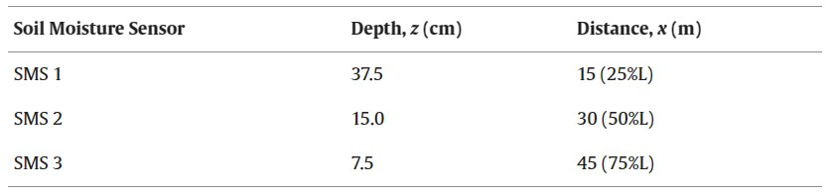
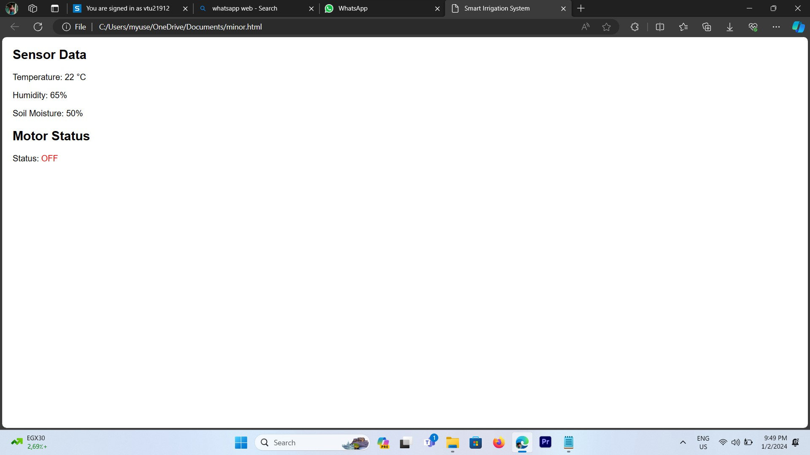
AUTOMATIC IRRIGATION WITH IOT MONITORIZING SOIL MOISTURE
Department of Computer Science & Engineering
School of Computing
10214CS601 – MINOR PROJECT
SUMMER SEMESTER 2023-2024
ABSTRACT
INTRODUCTION
RESULTS
STANDARDS AND POLICIES
Agriculture is the strength of Indian Economy. However, for agriculture water consumption is more than rainfall every year. Improving farm yield is essential to meet the rapidly growing demand of food for population growth across the world. By considering and predicting environmental circumstances, farm yield can be increased. Crop quality is based on data collected from field such as soil moisture, ambient temperature and humidity etc. Advanced tools and technology can be used to increase farm production. Developing IoT technologies can help to collect large amount of environmental and crop recital data.
“IoT encompasses many new intelligent concepts for using in the near future such as smart home, smart city, smart transportation, and smart farming”. The technique can be used for application of accurate amount of fertilizer, water, pesticide etc. to enhance productivity and excellence. Sensors are hopeful device for smart agriculture. The real time environmental parameters like soil moisture level, temperature and tank water level have continuous influence on the crop lifecycle. By forming sensor network, good monitoring of water regulation in the agriculture field can be achieved.
This presents irrigation monitoring and controlling system. The system was developed to monitor the environmental conditions such as temperature, soil moisture content, humidity of the air and water level of agriculture land for controlling the irrigation. The real time conditions sensed data is send to the cloud server for storing and decision making and controlling actions for future also.
The user device serves as an interface, displaying these values to the user and enabling manual intervention if needed. Additionally, feedback from the user device can influence the system, allowing users to remotely control and monitor the irrigation process. This holistic flow ensures efficient, automated irrigation while keeping users informed and engaged
The systems can be programmed to turn on and off at specific times or based on certain conditions, such as soil moisture levels or weather patterns. They can also be controlled remotely through a smartphone or other mobile device, making it easy for farmers and homeowners to monitor and adjust their irrigation systems from anywhere.
This project aims to develop an innovative and efficient irrigation system that utilizes IoT technology and soil moisture sensors to optimize the irrigation process and to Cultivate ,the main objective of our project is water conservation, automated irrigation, remote monitoring and control by incorporating IOT technology. We use soil moisture sensor, data transmission, decision-making algorithm, automated actuation and remote access to control the irrigation process .By using these technologies, we can efficiently store water ,increase crop yield ,reduce cost, environmental sustainability and data-driven insights .
CONCLUSIONS
An automatic check gate has been developed for the basin and connected to IoT through the wireless soil moisture sensor network using GSM with the aim that farmers/users can operate the gate opening and closing remotely with minimum manual interventions.Farmer can get the real-time moisture status of the field remotely and can make a decision of irrigation start and end on the basic real-time moisture status. The system was successfully tested in bare loamy soil. The study also attempted to identify the suitable location and number of sensors in the field to increase irrigation application efficiency. Three operational schedules based on a different combination of depth and length along the flow had been evaluated, which indicated that at least two soil moisture sensors are required for the efficient operation of the system.
Fig : output image
METHODOLOGIES
TEAM MEMBER DETAILS
1. Vtu19478/Bhuvaneswari S
2. Vtu19494/G Rupesh
3. Vtu19496/Yazhini G
1. 9701176062
2. 9789131008
3. 9677470400
1. vtu19478@veltech.edu.in
2. vtu19494@veltech.edu.in
3. vtu19496@veltech.edu.in
Step 1: Soil moisture sensor that senses the moisture content of the soil and send the information to the Arduino UNO (Microcontroller).
Step 2:By use of ArduinoDroid we implement the code for Arduino software that takes the decision to serve water to the land through relay module and water pump from water tank.
Step 3:Further to display the Moisture level and Water pump status(On or Off) Lcd display is connected with Arduino and Relay module.
Step 4:Our project is fully Automated, it reduces Labour intensive and increase in Water conservation.
ACKNOWLEDGEMENT
Supervisor Name : Dr.M.Sankar/Professor
Phone Number: 9994261887
Email: drsankarm@veltech.edu.in
Fig : Output Image After Processing

